Slide 1

EXPLAINABLE ML

Slide 2
Why do we need Shap - values?
SHAP - Shapely Additive Explanations
SHAP values are used to explain individual model predictions. For a given prediction, they tell us how each feature has contributed to that prediction or average marginal contribution of an instance of a feature among all possible coalitions.
SHAP value = contribution to prediction
With the help of shap values many machine learning models can be interpreted however it depends on the complexity of the model and the interaction between the features.

Slide 3

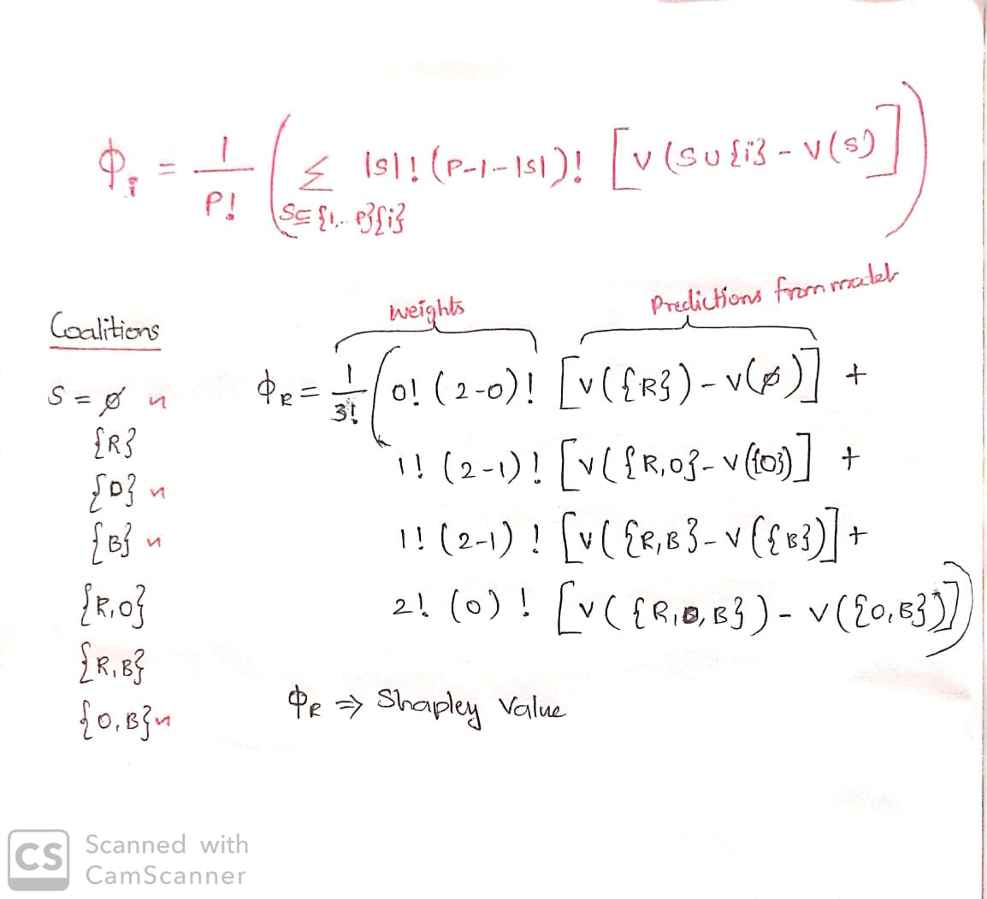
Calculating individual Shap - values
S - No of variables in coalition
I - Variable whose contribution to be found
P – Total number of variables
Instance for calculating shapley value for an observation of a feature(regression):
-
-
-
-
Each color represents a variable

Slide 4
Types of Shap
Classic Shapley values
Tree shap
Kernel shap
Deep shap
Linear shap
Based on the type of model to be interpreted , model specific shap approximations can be used for better reliable values. The computation to find shapley values behind each shap type are different and time to compute differs too.
Kernel Shap: This can be applied to any type of machine learning model, including linear models, decision trees, random forests, gradient boosting models, deep neural networks, and more. We will try calculating shapley values using this.

Slide 5
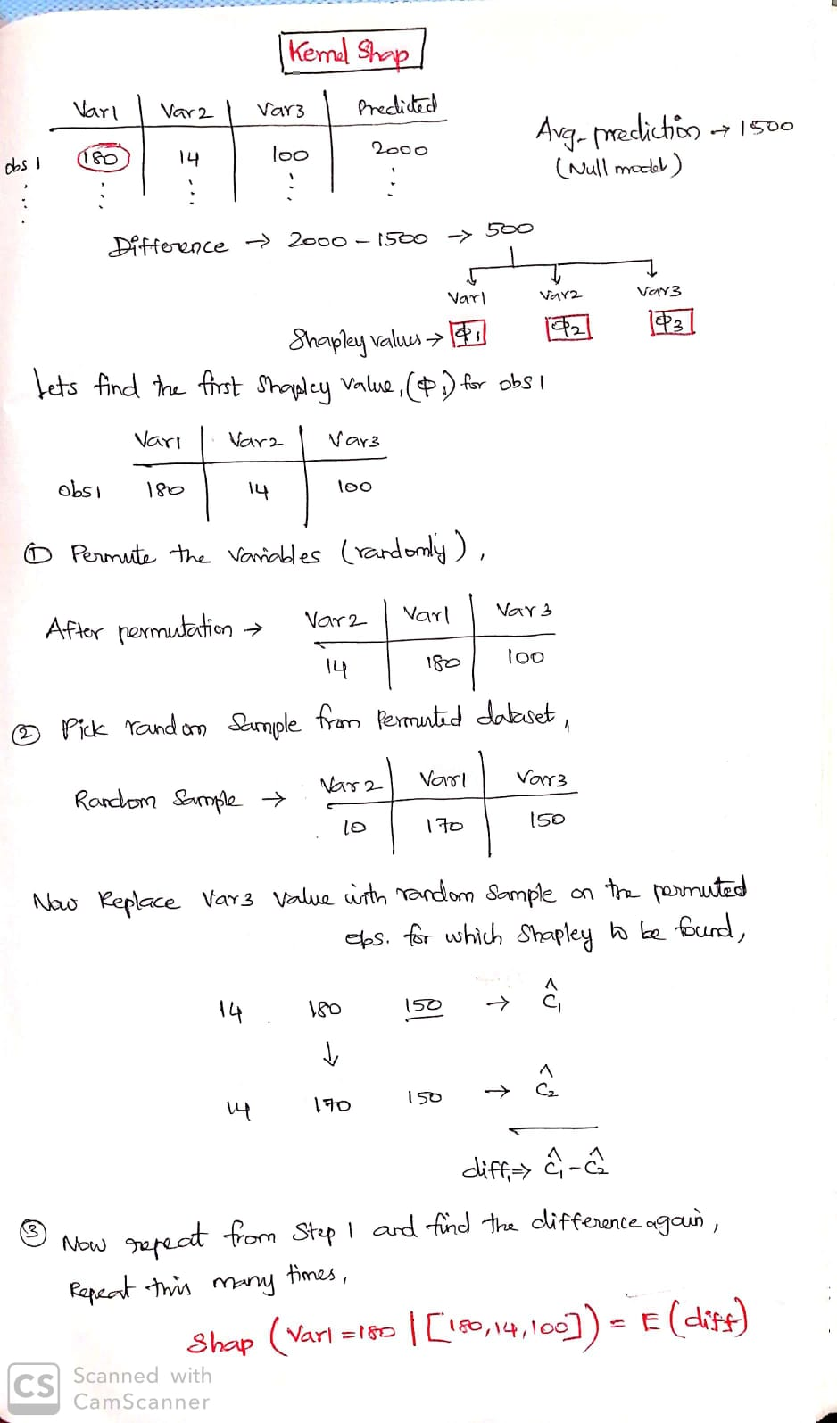
Computation behind Kernel shap

Slide 6
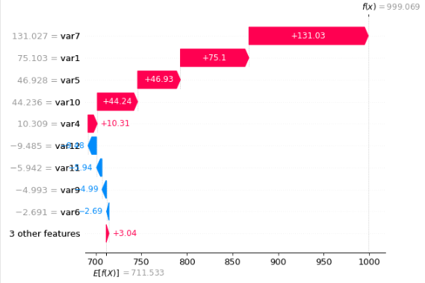
Interpretation
Base value is when there is no variable in the model (i.e. Null model prediction)
Base value + sum(Shap values) = Predicted value
From the graph , we can see how each variable is influencing either to increase or decrease the prediction.

Slide 7
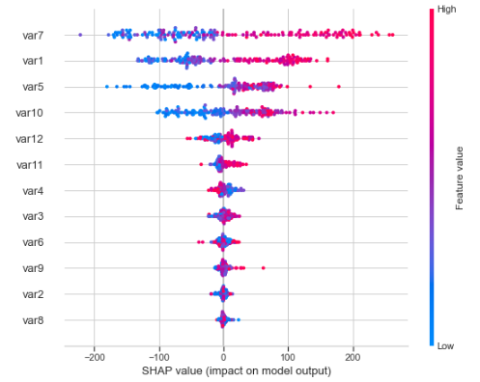
Variable importance and Relationship
Variables are arranged in order of importance(global) for prediction.
Inferences from Beeswarm plots:
In Var7,When the feature value(actual value)
increases the shap value increase too which
shows var7 is contributing in increasing the
prediction.(i.e. Positive correlation between Var7
and the target)
Whereas in Var4 , when the actual value increases the shap value decreases which shows there is weak(less spread to the left) negative correlation between Var4 and Target.
Var8 has has no contribution towards prediction.
Beeswarm plot

Slide 8
Limitations of shap
Model dependency
SHAP values may not be directly comparable between different models.
Interpretation difficulty
SHAP values can become difficult to interpret when large number of features involved.
Model agnostic
Theoretically yes. But practically its not available(packages) to all models.
Feature dependency
Shap calculations assumes features are independent. If there is dependencies it will lead to
unrealistic shap values.
Causal analysis
Shap can only tell how important a feature is to prediction but not to target variable.

Slide 9
References:
https://adataodyssey.com/courses/shap-with-python/ (Data odyssey)
https://www.youtube.com/watch?v=IqT551LjKHw(Code emporium)
https://www.youtube.com/watch?v=VB9uV-x0gtg&t=459s (kie)
https://www.youtube.com/watch?v=NBg7YirBTN8 (Ritvik math)
https://towardsdatascience.com/shap-explained-the-way-i-wish-someone-explained-it-to-me-ab81cc69ef30 (medium)
https://www.youtube.com/watch?v=u7Om2joZWYs&t=344s (datascience garage)
Github Link:
https://github.com/bb1810/SHAP-_-Interpreting-models/upload/main

